Slide 1
Operating Systems
Lecture 1

Slide 2
Agenda for Today
Introduction and purpose of the course
Organization of a computer system
Purpose of a computer system—setting the stage for OS concepts and principles
Outline of topics to be discussed in the course
What is an operating system?
Recap of the lecture

Slide 3
Computer System
Hardware
Operating system
Applications programs
Users

Slide 4

Layered View of a Computer System

Slide 5

Purpose of a Computer System
Computer systems consist of software and hardware that are combined to provide a tool to solve specific problems in an efficient manner
Execute programs

Slide 6
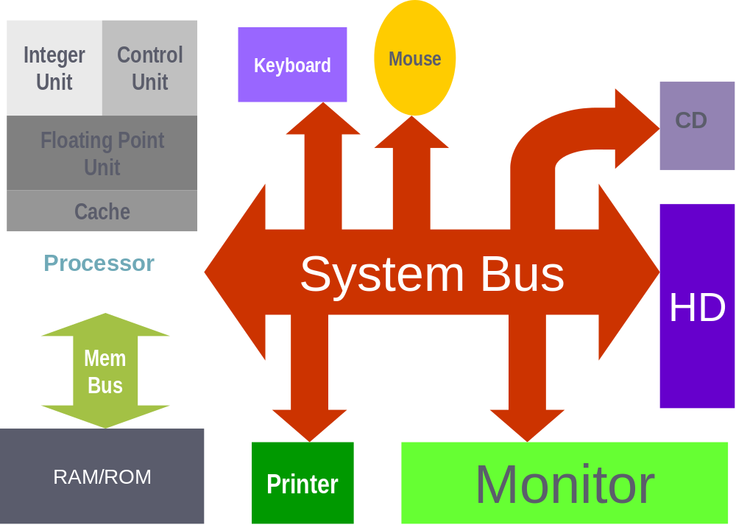
Computer System Hardware

Slide 7
Course Outline
Operating system concepts
Operating system structures
Introduction to UNIX/Linux user interface
Processes and threads—scheduling, concurrency, synchronization, etc.
Deadlocks
Memory management
Virtual memory
File system
Secondary storage management

Slide 8
Operating System Concepts
Single-user systems
Batch systems
Multiprogrammed systems
Time-sharing systems
Real-time systems
Interrupts, traps, and software interrupts (UNIX signals)
Hardware protection

Slide 9
Operating System Structures
Operating system services
System calls
Semantics of system call execution
Operating system structures (monolithic, microkernel-based, layered, virtual machines, DOS-Windows, UNIX)
System design and implementation

Slide 10
Introduction to UNIX/Linux
Directory structure
Browsing directory structure
Useful commands

Slide 11
Processes
Process concept (process, states, attributes, etc.)
Process scheduling (scheduler)
Context switching (dispatcher)
Operations on processes (creation, termination, signaling, suspend, foreground, background, etc.)
Process management in UNIX (fork, wait, exec, exit, etc.)

Slide 12
Processes (continued)
Sample code for UNIX/Linux process management
Cooperating processes
Interprocess communication (IPC)
IPC in UNIX/Linux (pipe, FIFO, socket, message queue, etc.)

Slide 13
Processes (continued)
Communication between UNIX/Linux processes (pipe, mkfifo, read, write, close, etc.)
Sample code
UNIX/Linux processes (process images, control structures, etc. explained with sample code)
Managing UNIX/Linux processes (ps, top, fg, bg, <Ctrl-Z>, <Ctrl-C>, etc.)

Slide 14
Threads
Thread concept (thread, states, attributes, etc.)
User- and kernel-level threads
POSIX threads (the pthread library)
Sample code

Slide 15
CPU Scheduling
Basic concepts
Scheduling criteria
Scheduling triggers
Scheduling algorithms
UNIX System V scheduling algorithm
Optimal scheduling
Algorithm evaluation

Slide 16
Process Synchronization
Basic concept
The Critical Section Problem
Solutions for the Critical Section Problem
Software-based solutions—the Bakery Algorithm
Hardware-based solutions
Semaphores
Binary and counting semaphores

Slide 17
Process Synchronization …
Classic problems of synchronization
Deadlocks and starvation
Critical regions
Monitors
Synchronization tools used in Solaris, Linux, and Windows
Deadlocks and starvation
Pthread library functions

Slide 18
Deadlocks
Basic concept
Deadlock characterization
Deadlock handling (prevention, avoidance, detection and recovery)
Banker’s algorithm

Slide 19
Memory Management
Basic concepts
Various techniques for memory management
Logical to physical address translation
Swapping
Contiguous memory allocation: MFT, MVT
External fragmentation
Paging
Hardware support for paging
Internal fragmentation

Slide 20
Memory Management …
Performance of paging
Protection and sharing
Page table issues: Multi-level paging, Hashed page tables, Inverted page tables
Segmentation
Protection and sharing
Segmentation with paging
Intel P4 example

Slide 21
Virtual Memory
Basic concept
Demand paging
Page fault
Performance of demand paging
Page replacement
Allocation of frames
Thrashing
Operating-system examples
Other considerations (I/O locking, page size, …)

Slide 22
File System Interface
Basic concepts (file attributes, operations, types, structure, etc.)
Access methods (sequential, random, etc.)
Directory structure
UNIX/Linux directory structure (links in UNIX)
File system mounting, sharing, and protection
UNIX/Linux examples for sharing and protection, and relevant commands (chmod, ln, ln –s, etc.)

Slide 23
File System Implementation
Basic concepts (overview of disk structure, file structure, boot control block, super block, inode, per process file descriptor table, system-wide open-file table, etc.)
Directory implementation
Free space management methods
Space Allocation Methods
Time and space performance of allocation methods
Brief introduction to Network File System (NFS)

Slide 24
Mass Storage Structure and Scheduling
Disk structure and scheduling
Disk management (formatting, boot block, bad blocks, etc.)
Course Recap

Slide 25
What is an Operating System?
A program that acts as an intermediary between a user of a computer and the computer hardware—provides the user a simpler (virtual) machine to work with
A program that allocates and deallocates computer system resources in an efficient, fair, and secure manner—a resource manager

Slide 26
Operating System Goals
Execute user programs and make solving user problems easier.
Make the computer system convenient to use.
Use the computer hardware in an efficient manner.

Slide 27
Operating Systems
Lecture 1

Slide 28
Operating Systems
Lecture 2

Slide 29
Agenda for Today
Review of previous lecture
Single-user systems
Batch systems
Multiprogrammed systems
Time-sharing systems
Real-time systems
Interrupts, traps, and signals
CPU, I/O, and memory protection
Recap of the lecture

Slide 30

Single User Systems
Personal computers – computer system dedicated to a single user.
Interactive
User convenience and responsiveness.

Slide 31
Single User Systems
Can adopt technology developed for larger operating systems—multi-process, multi-user
Individuals usually have sole use of computer and do not need advanced protection features.
May run several different types of operating systems (Windows, MacOS, UNIX, Linux)

Slide 32

Batch Systems
First rudimentary system.
User ≠ operator
Reduce setup time by batching similar jobs
Automatic job sequencing – automatically transfers control from one job to another.
Resident monitor :
  initial control in monitor
  control transfers to job
  when job completes control transfers back to monitor

Slide 33

Memory Layout

Slide 34

Multiprogrammed Systems
Several jobs are kept in main memory at the same time, and the CPU is multiplexed among them.

Slide 35
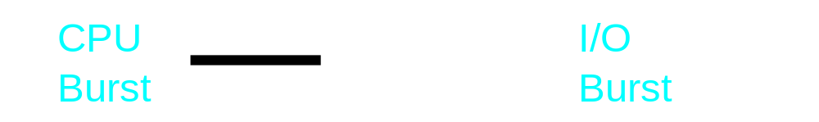


Multiprogrammed Systems
Example: Two processes P1 and P2 with CPU and I/O bursts of one time unit each

Slide 36
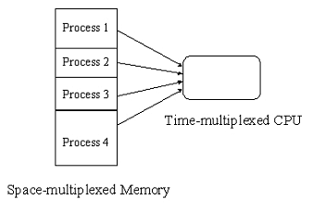
OS Features Needed for Multiprogramming
SPOOLing (Simultaneous Peripheral Operation On-Line)
Memory management
CPU scheduling

Slide 37

Time-sharing Systems
An interactive system with multiprogramming
A job is swapped in and out of memory to the disk if needed.
On-line file system must be available for users to access data and code.

Slide 38

Real-time Systems
Well-defined fixed-time constraints.
Often used as a control device in a dedicated application such as controlling scientific experiments, medical imaging systems, industrial control systems, and some display systems.
Real-Time systems may be either hard or soft real-time.

Slide 39
Real-time Systems …
Hard real-time systems:
  Secondary storage limited or absent, data stored in short term memory, or read-only memory (ROM)
  No virtual memory—time cannot be “wasted” on translation of logical to physical addresses
  OS code structured for efficiency
  Plane landing systems, process control in nuclear power plants, respirators, etc.

Slide 40
Real-time Systems ...
Soft real-time systems
  Output should be produced within the given time constraints but if it is not, the result is not life threatening
  Useful in applications (multimedia, virtual reality) requiring advanced operating-system features.

Slide 41


Interrupts, Traps, and Signals
The occurrence of an event is usually signaled by an interrupt from either the hardware or the software.
Hardware may trigger an interrupt at any time by sending a signal to the CPU usually by way of the system bus.
Software may trigger an interrupt by executing a special operation called a system call.
Answer the Phone
.
.
.
Resume

Slide 42
Interrupts, Traps, and Signals
A process can generate a trap, for example, by dividing a number by zero.
A user or a process may generate a signal (an interrupt to a process)
Answer the Phone
.
.
.
Resume

Slide 43
Interrupt Handling
Interrupt transfers control to the interrupt service routine, generally, through the interrupt vector, which contains addresses of all the interrupt service routines.
Interrupt architecture must save the address of the instruction after the interrupted instruction and the CPU state so that execution of the interrupted process may continue after the interrupt has been serviced.

Slide 44
Interrupt Handling …
Incoming interrupts are disabled while another interrupt is being processed to prevent lost interrupts.
An operating system is interrupt driven.

Slide 45
Hardware Protection
Dual-Mode Operation
I/O Protection
Memory Protection
CPU Protection

Slide 46
Dual-Mode Operation
Sharing system resources requires operating system to ensure that an incorrect program cannot cause other programs to execute incorrectly.
Provide hardware support to differentiate between at least two modes of operations.
  User mode – execution done on behalf of a user.
  Monitor mode (also kernel mode or system mode) – execution done on behalf of operating system.

Slide 47
Dual-Mode Operation …
Mode bit added to computer hardware to indicate the current mode: monitor (0) or user (1).
When an interrupt or fault occurs hardware switches to monitor mode.
Interrupt/fault
monitor
user
set user mode
Privileged instructions can be issued only in monitor mode.

Slide 48
Recap of Lecture
Single-user systems
Batch systems
Multiprogrammed systems
Time-sharing systems
Real-time systems
Interrupts, traps, and signals
Privileged instructions
I/O protection
Recap of the lecture

Slide 49
Operating Systems
Lecture 2

Slide 50
Operating Systems
Lecture 3

Slide 51
Agenda for Today
Review of previous lecture
Hardware (I/O, memory, and CPU) protection
Operating system components and services
System calls
Operating system structures
Operating system design and implementation
Recap of the lecture

Slide 52
Hardware Protection
Dual-Mode Operation
I/O Protection
Memory Protection
CPU Protection

Slide 53
I/O Protection
All I/O instructions are privileged instructions.
Must ensure that a user program could never gain control of the computer in monitor mode (i.e., a user program that, as part of its execution, stores a new address in the interrupt vector).

Slide 54

Use of A System Call to Perform I/O

Slide 55
Memory Protection
Must provide memory protection outside the address space of a process.
In order to have memory protection, add two registers that determine the range of legal addresses a program may access:
  Base register – holds the smallest legal physical memory address.
  Limit register – contains the size of the range
Memory outside the defined range is protected.

Slide 56

Use of Base and Limit Register

Slide 57

Hardware Support

Slide 58
CPU Protection
Timer – interrupts computer after specified period to ensure operating system maintains control.
  Timer is decremented every clock tick.
  When timer reaches the value 0, an interrupt occurs.
Timer commonly used to implement time sharing.
Time also used to compute the current time.
Load-timer is a privileged instruction.

Slide 59
OS Components
Process management
Main memory management
Secondary storage management
I/O system management
File management
Protection system
Networking
Command-line interpreter (shells)

Slide 60
Operating System Services
Services for user and users of programs:
Program execution
I/O Operations
File System Manipulation
Communications between processes/users
Error detection and handling

Slide 61
Operating System Services …
Services for efficient system operation:
Resource management
Accounting
Protection

Slide 62
OS Kernel
Users
Applications
Operating System API, AUI
Operating System Kernel
Computer Hardware
Real work is done in the kernel

Slide 63
Entry Points into Kernel
System Call Signal
Interrupt Trap

Slide 64
System Calls
User processes must not be given open access to the kernel code
The system call interface layer contains entry point in the kernel code
Any user or application request that involves access to any system resource must be handled by the kernel code

Slide 65
Types Of System Calls
Process Control
File Management
Device Management
Information maintenance
Communications

Slide 66
System Call Execution
The user program makes a call to a library function.
Library routine puts appropriate parameters at a well-known place (registers, stack, or a table in memory).
The trap instruction is executed to change mode from user to kernel.
Control goes to operating system.
Operating system determines which system call is to be carried out.

Slide 67
Semantics of System Call Execution …
Kernel indexes the dispatch table, which contains pointers to service routines for system calls.
Service routine is executed and return parameter or error code placed at well-known places (usually a CPU register).
Control given back to user program.
Library function executes the instruction following trap.

Slide 68
System Call …
Process
Library Call
System Call
trap
Dispatch Table
Service Code
Kernel Code

Slide 69

Operating System Structures
Simple Structure
Layered Approach
Microkernels
Virtual Machines

Slide 70

Simple Structures
MS-DOS : written to provide the most functionality in the least space, so it was not divided into modules carefully

Slide 71
Simple Structures …
UNIX consists of two separable parts, the kernel and the system programs.
Every thing below the system call interface and above the physical hardware is the kernel.
An enormous amount of functionality combined in one level, UNIX is difficult to enhance as changes in one section could adversely affect other areas.

Slide 72

UNIX System Structure

Slide 73
Recap of lecture
Review of previous lecture
Operating system components
Operating system services
System calls
Operating system structures
Recap of the lecture

Slide 74
Operating Systems
Lecture 3

Slide 75
Operating Systems
Lecture 4

Slide 76
Agenda for Today
Review of previous lecture
Operating system structures
Operating system design and implementation
UNIX/Linux directory structure
Browsing UNIX/Linux directory structure
Useful UNIX/Linux commands
Recap of the lecture

Slide 77
UNIX System Structure

Slide 78
Layered Approach
The OS is broken up into a number of layers
Bottom layer is hardware and the topmost layer ( layer N) is the user interface
A typical layer consists of data structures and a set of routines to service the layer above it
THE operating system by Dijkstra
IBM’s OS/2

Slide 79

Layered Approach …

Slide 80
Layered Approach …
Modularity
Each layer uses functions and services of only lower layers
Simplifies debugging and system verification.
The major difficulty with layered approach is careful definition of layers, because a layer can only use the layers below it
Less efficient than other approaches

Slide 81
Microkernel
Structures the operating system by removing all non-essential components from the kernel and implementing them as system and user level programs
Smaller kernel
Main function is to provide a communication facility between client programs and the various services that are also running in the user space.

Slide 82
Microkernel …
Easier to extend the OS—new services are added to user space and consequently do not require modification of the kernel and/or its recompilation
Easier to maintain operating system code (enhancement, debugging, etc.)
OS is easier to port from one hardware to another
More security and reliability
Mach, MacOS X Server, QNX, OS/2, and Windows NT

Slide 83

Windows NT Client-Server Structure

Slide 84
Virtual Machines
CPU scheduling and virtual memory techniques used to emulate hardware of the underlying machine, on which user can install an operating system that the virtual machine supports
On a time-sharing system with virtual machine support, users may be working on different operating systems
Pioneered by IBM VM operating system that ran CMS, a single-user interactive operating system

Slide 85
Virtual Machines …
Difficult to implement.
System development done without disrupting normal system operation.

Slide 86

Virtual Machines …
Non Virtual Machine Virtual Machine

Slide 87
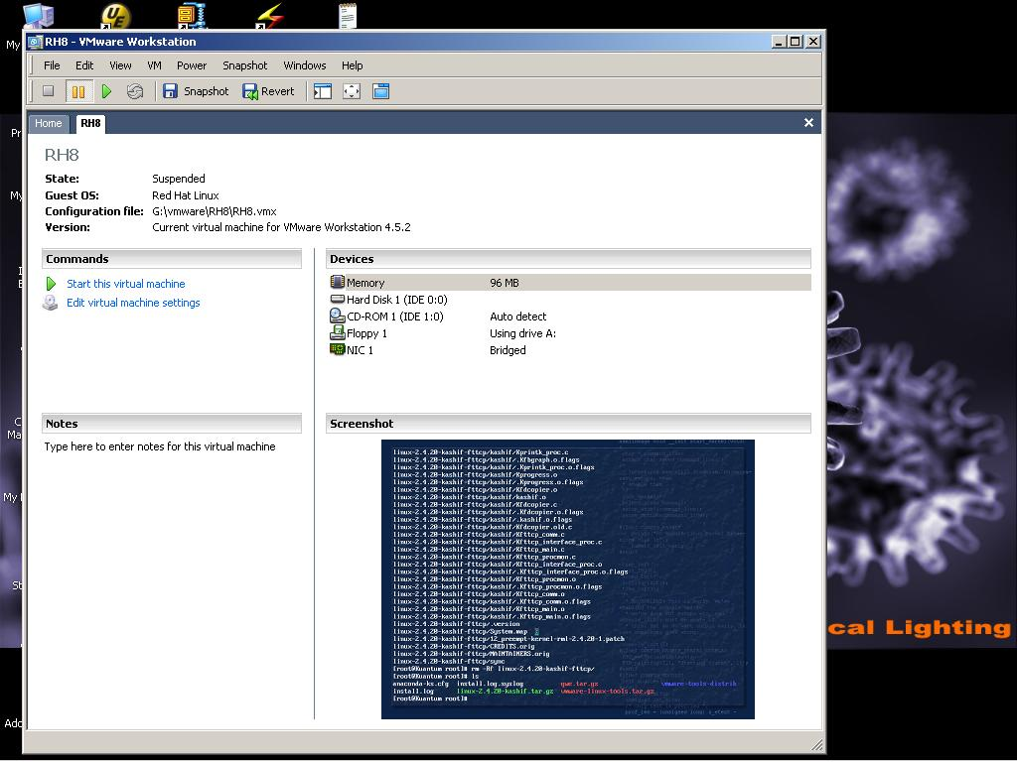
VMWare on Windows

Slide 88
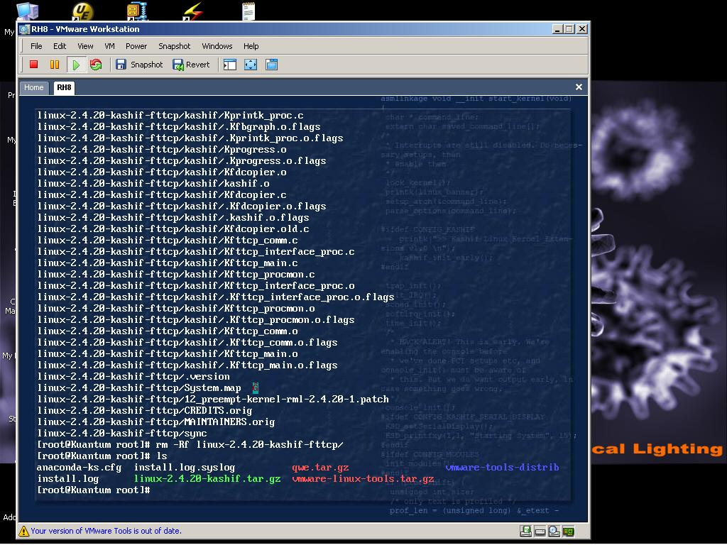
VMWare on Windows

Slide 89

Java Virtual Machine

Slide 90
System Design and Implementation
Design Goals
User: operating system should be convenient to use, easy to learn, reliable, safe, and fast.
System designer and administrator: operating system should be easy to design, implement, and maintain, as well as flexible, reliable, error-free, and efficient.

Slide 91
System Design and Implementation …
Mechanism: determine how to do something
Policy: determine what will be done
Separation of mechanism and policy is important for flexibility.

Slide 92
System Design and Implementation …
Implementation in:
Assembly language
Higher level languages:
  Easier to code
  Compact code
  Easier to port

Slide 93
Introduction to UNIX and Linux
Written by Dennis Ritchie and Ken Thomsom in at Bell Labs in 1969
Initially written in assembly language and a high-level language called B. Later converted from B to C language.
Linux written by Linus Torvalds (an undergraduate student at the Univ. of Helsinki, Finland) in 1991.
Most popular operating systems
Internet runs on UNIX and Linux

Slide 94
UNIX/Linux File System
UNIX has a hierarchical file system structure consisting of a root directory with other directories and files hanging under it
In a command-line user interface, typed commands are used to navigate the system
Directories and files are specified by filenames
  cs604/assignments/assign1.c
  /home/students/haroon/courses/cs604

Slide 95
Browsing Directory Structure
/ | The root directory is the directory that contains all other directories. When a directory structure is displayed as a tree, the root directory is at the top.
/bin | This directory holds binary executable files that are essential for correct operation of the system
/boot | This directory includes essential system boot files including the kernel image .

Slide 96
Browsing Directory Structure …
/dev | This directory contains the devices available to on the machine
/etc | Linux uses this directory to store system configuration files
/home | This is where every user on a Linux system has a personal directory
/lib | Shared libraries and kernel modules are stored in this directory

Slide 97
Browsing Directory Structure …
/root | The home directory for the superuser
/sbin | Utilities used for system administration (halt, ifconfig, fdisk, etc.) are stored in this directory
/tmp | Used for storing temporary files. Similar to C:\Windows\Temp.

Slide 98
Browsing Directory Structure …
/usr | Typically a shareable, read-only directory. Contains user applications and supporting files for those applications.
/var | This directory contains variable data files such as logs (/var/log), mail (/var/mail), and spools (/var/spool) among other things.

Slide 99
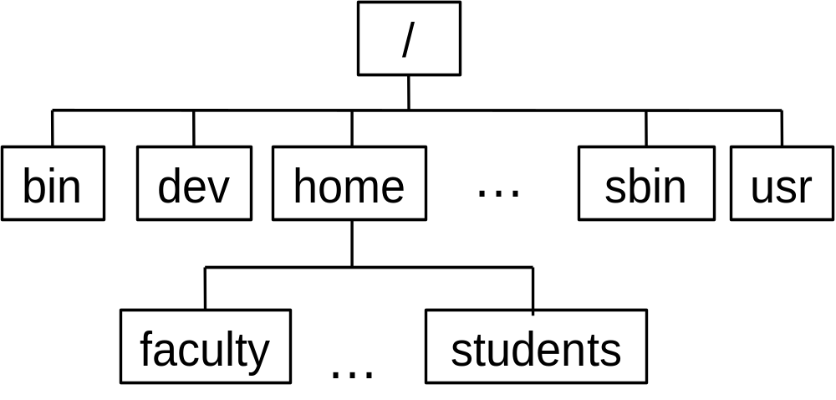
UNIX/Linux Directory Hierarchy

Slide 100
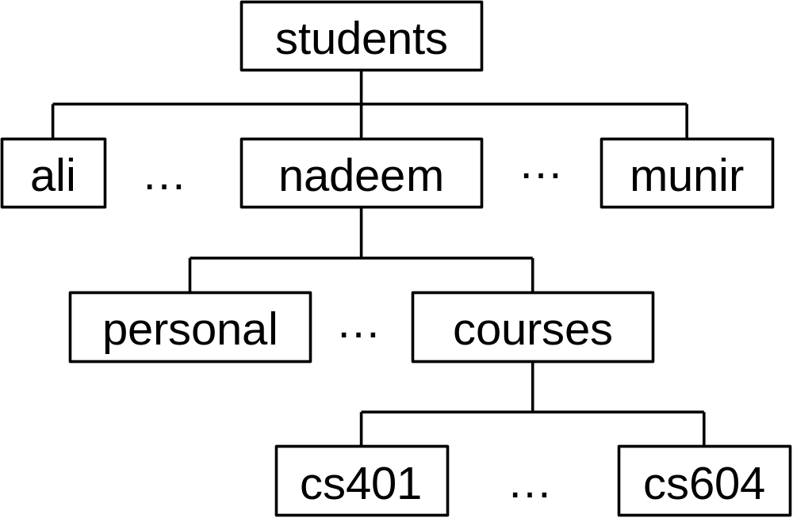
UNIX/Linux Directory Hierarchy

Slide 101
Recap
Review of previous lecture
Operating system structures
Operating system design and implementation
UNIX/Linux directory structure
Recap of the lecture

Slide 102
Operating Systems
Lecture 4

